Slide 1
PREDICTING HOUSE PRICES USING MACHINE LEARNING
LOADING AND DATASET

Slide 2
INTRODUCTION
Accurately estimating the value of real estate is an important problem for many stakeholders including house owners, house buyers, agents, creditors, and investors. It is also a difficult one.

Slide 3
Machine learning algorithm
Machine learning algorithms In this study two machine learning algorithms were compared against each other in order to investigate which one is more successful in predicting housing prices. As mentioned in the previous section, Baldominos et al. [3] performed a similar study in which they compare four machine learning algorithms for housing prices. In their study they found that the Random forest regression algorithm predicted with the smallest error followed by k-Nearest neighbours regression

Slide 4
K Nearest Neighbours
K-Nearest neighbours (k-NN) is a non-parametric algorithm that can be used for both classification and regression problems. The algorithm relies on the assumption that any item in the data set should be have a similar value for the prediction target if they share similar values for other features. In our particular case, the house price is the target variable that is predicted by the k number of neighbours that are the most similar in the features.

Slide 5
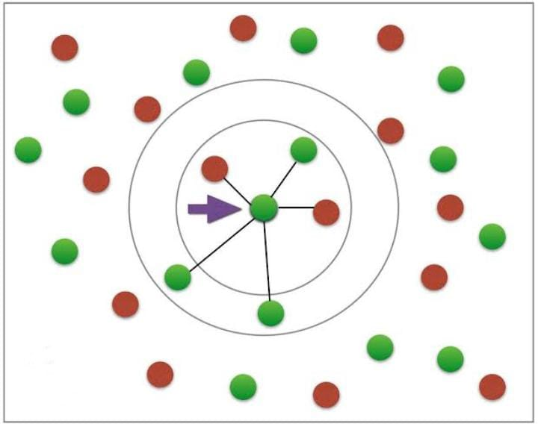

Slide 6
Random Forest Regression
Random forest is an algorithm which can be used both for classification and regression. Random forest models are constructed by using a collection of decision trees based on the training data. Instead of taking the target value from a single tree, the Random forest algorithm makes a prediction on the average prediction of a collection of trees. The decision trees themselves are constructed by fitting to randomly drawn groups of rows and columns in the training data.

Slide 7
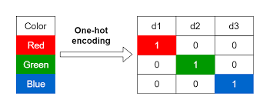
Encoding categorical data
Many of the variables of the
data set are categorical, and
take on a limited set of values.
One example is the nominal
variable ”Street” which represents
the type of road access to the property
and takes on the values ”Grvl” for grave
l and ”Pave” for paved. Such categorical
values can not be interpreted by
conventional machine learning
algorithms without preprocessing them
to a numerical format.

Slide 8
THANK YOU

